Slide 1
Node.js

Slide 2
Introduction
Node.js is a very powerful JavaScript-based platform built on Google Chrome's JavaScript V8 Engine.
It is used to develop I/O intensive web applications like video streaming sites, single-page applications, and other web applications.
Node.js is a platform built on Chrome's JavaScript runtime for easily building fast and scalable network applications.
Node.js allows us to run JavaScript on server.

Slide 3
Features of Node.js
Asynchronous and Event Driven − All APIs of Node.js library are asynchronous, that is, non-blocking. It essentially means a Node.js based server never waits for an API to return data. The server moves to the next API after calling it and a notification mechanism of Events of Node.js helps the server to get a response from the previous API call.
Very Fast − Being built on Google Chrome's V8 JavaScript Engine, Node.js library is very fast in code execution.

Slide 4
Features of Node.js
Single Threaded but Highly Scalable − Node.js uses a single threaded model with event looping.
Event mechanism helps the server to respond in a non-blocking way and makes the server highly scalable as opposed to traditional servers which create limited threads to handle requests.
Node.js uses a single threaded program and the same program can provide service to a much larger number of requests than traditional servers like Apache HTTP Server.
No Bufferring − Node.js applications never buffer any data. These applications simply output the data in chunks.

Slide 5
Features of Node.js
Node.js uses asynchronous programming!
A common task for a web server can be to open a file on the server and return the content to the client.
PHP or ASP handles a file request
Sends the task to the computer's file system.
Waits while the file system opens and reads the file.
Returns the content to the client.
Ready to handle the next request.
Node.js handles a file request:
Sends the task to the computer's file system.
Ready to handle the next request.
When the file system has opened and read the file, the server returns the content to the client.
Node.js eliminates the waiting, and simply continues with the next request.

Slide 6
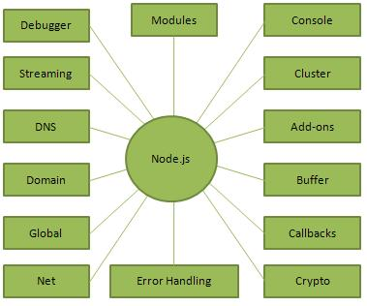
Parts of Node.js
The following diagram depicts some important parts of Node.js

Slide 7
Where to use Node.js
Where to Use Node.js
Following are the areas where Node.js is proving itself as a perfect technology partner.
I/O bound Applications
Data Streaming Applications
Data Intensive Real-time Applications (DIRT)
JSON APIs based Applications
Single Page Applications

Slide 8
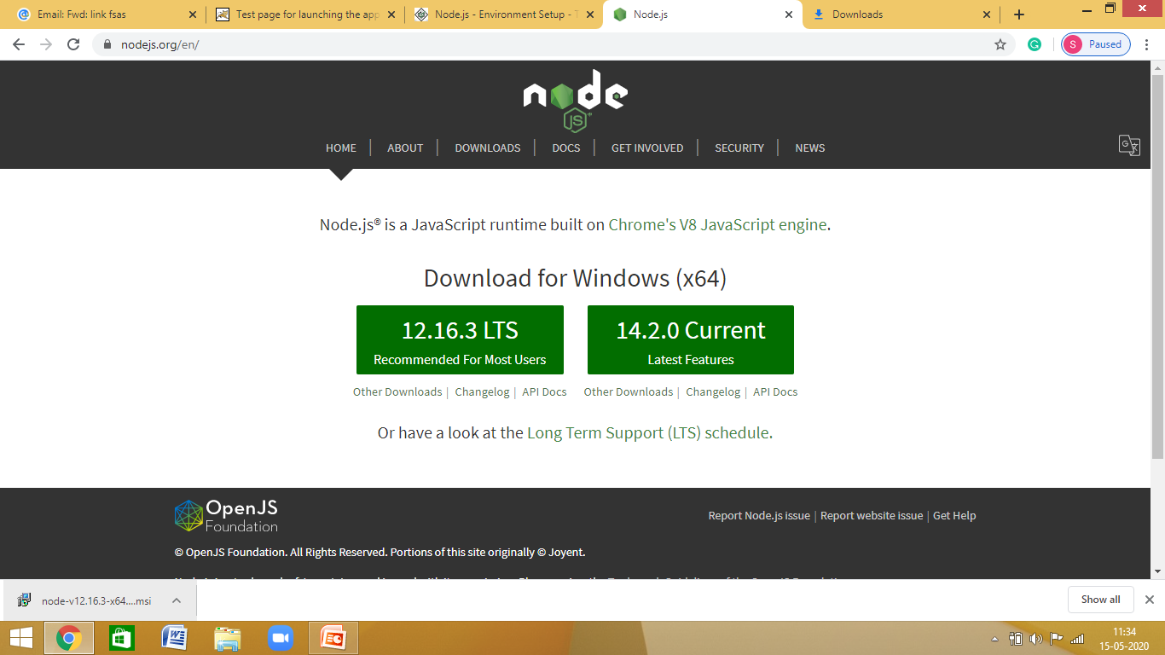
Installation
https://nodejs.org/en/
Download 12.16.3 LTS recommended for most users

Slide 9
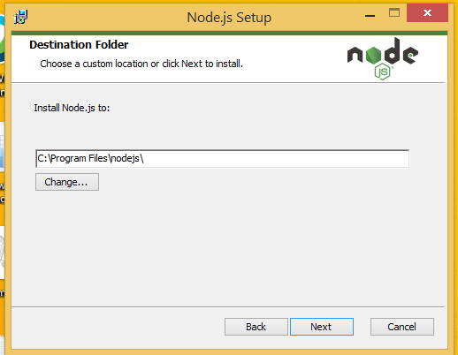
Installation
Default settings and click next
Choose the option Automatically in “Tools for Native Modules”

Slide 10
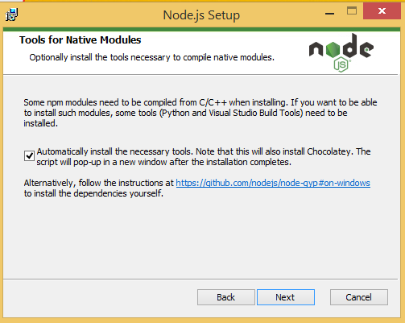
Installation
Choose the option

Slide 11
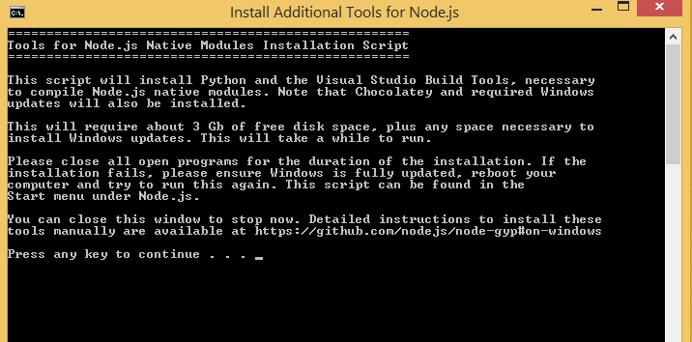
Installation
Press Enter and complete installation.

Slide 12
Test Installation
Make a new folder with any name like ‘nodejs’
Open folder nodejs using VS Code. (Please install VS Code)
Make a new file ‘main.js’
Write simple code in main.js
console.log(“Hello World”);
Execute main.js using below command in Terminal
node main.js

Slide 13
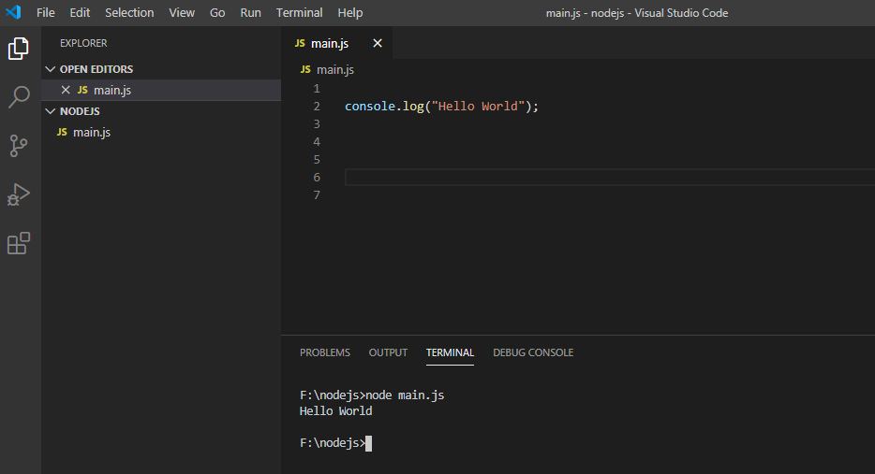
Test Installation
See the output in Screen

Slide 14
Node.js Console (REPL)
Node.js comes with virtual environment called REPL (aka Node shell). REPL stands for Read-Eval-Print-Loop. It is a quick and easy way to test simple Node.js/JavaScript code.
To launch the REPL (Node shell), open command prompt (in Windows) or terminal (in Mac or UNIX/Linux) and type node as shown below. It will change the prompt to > in Windows and MAC.

Slide 15
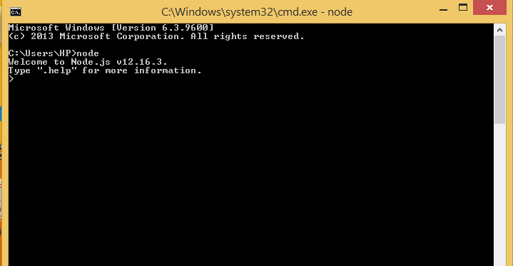
Node.js Console (REPL)
Command Prompt View
To Exit use twice Ctrl+c

Slide 16
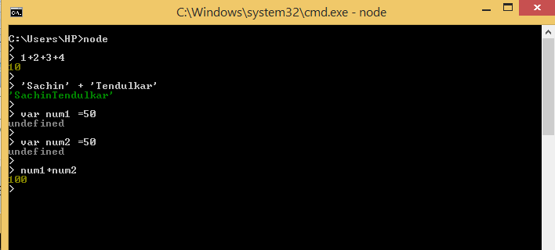
Node.js Console (REPL)
Perform Operations
Command for clearing Node shell is Ctrl+l

Slide 17
Basics
Node.js supports JavaScript. So, JavaScript syntax on Node.js is similar to the browser's JavaScript syntax.
Primitive Types
Node.js includes following primitive types:
String
Number
Boolean (Datatype that returns either of two values i.e. true or false)
Undefined (Undefined means a variable has been declared, but the value of that variable has not yet been defined)

Slide 18
Basics
Primitive types (Continued)
Null (Null means an empty or non-existent value. Null is assigned,
and explicitly means nothing. )
RegExp (A regular expression is an object that describes a pattern of characters. Regular expressions are used to perform pattern-matching and "search-and-replace" functions on text)
Everything else is an object in Node.js.

Slide 19
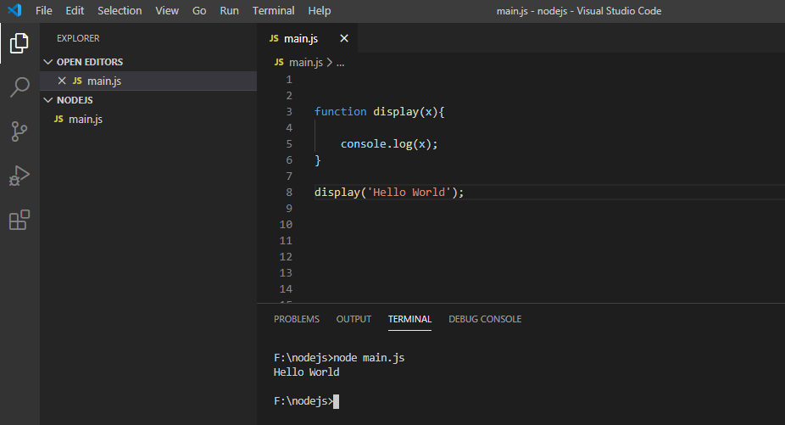
Functions
function function_name (perimeter) {
Operation to Perform }

Slide 20
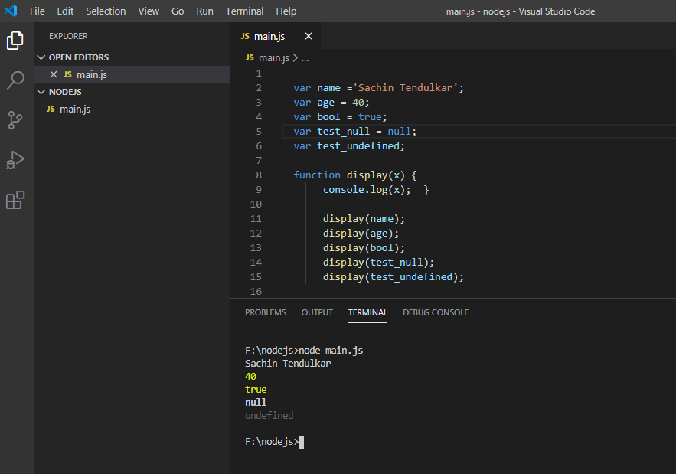
Functions
Using String, Number, null, undefined , boolean

Slide 21
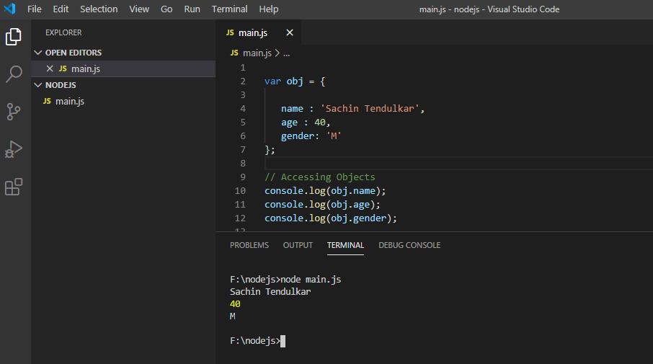
Objects
Declaring and Using Objects

Slide 22
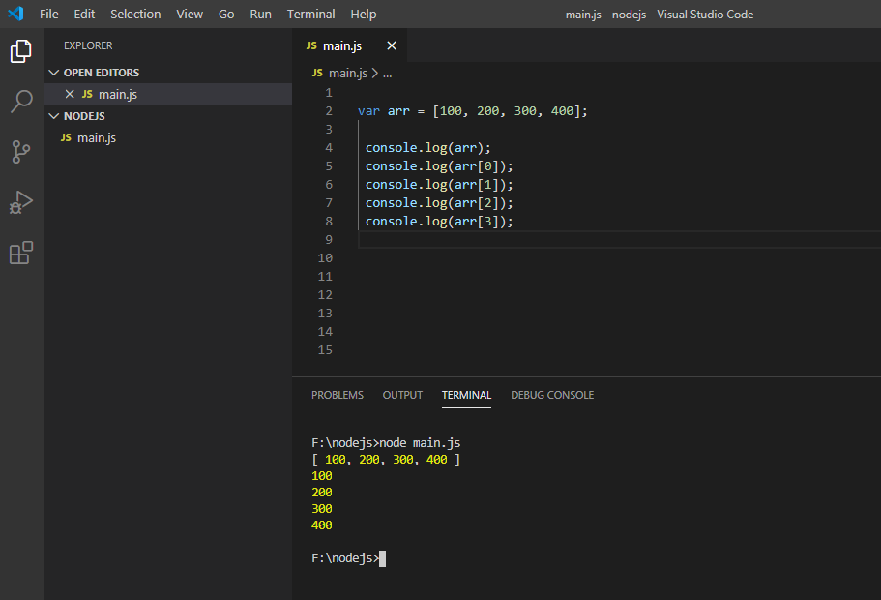
Array
Using Arrays

Slide 23
Modules in Node.js
Modules are just like JavaScript libraries.
Module is a set of functions you want to include in your application.
Node.js has three types of modules:
Core Modules (In-built Modules)
Local Modules
Third Party Modules
We can also code our own modules

Slide 24
Core Modules
Node.js is a light weight framework. The core modules include bare minimum functionalities of Node.js.
These core modules are already compiled and they got loaded automatically when Node.js process starts.
We need to import the core module first in order to use it in your application.

Slide 25
Core Modules
Few Core Modules are listed below:
Core Module | Usage
http | http module includes classes, methods and events to create Node.js http server.
path | path module includes methods to deal with file paths.
fs | fs module includes classes, methods, and events to work with file I/O.

Slide 26
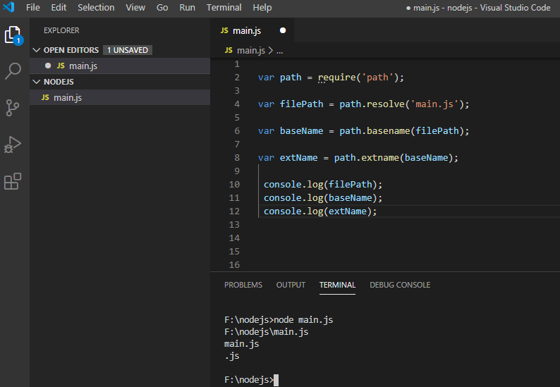
Using Core Module
Using ‘path’ module

Slide 27
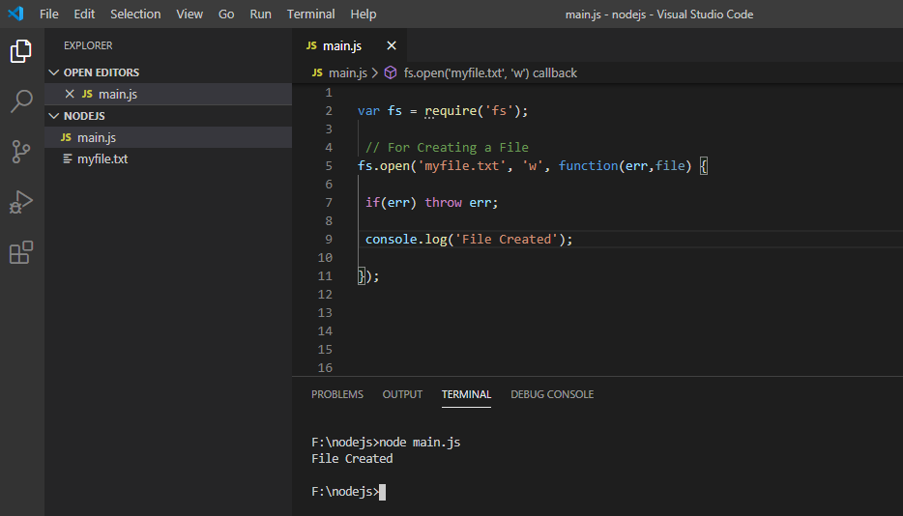
Using Core Modules
Using ‘fs’ module

Slide 28
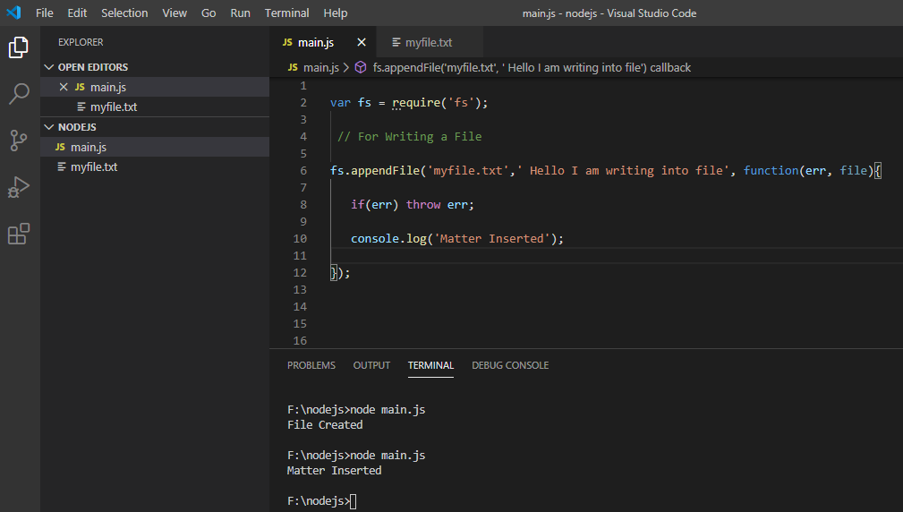
Using Core Module
Using ‘fs’ modules
Now after executing open the file ‘myfile.txt’

Slide 29
Implementing Local Modules
Create a new file ‘local_modules.js’
Write the desired code :
We created an object with name ‘Log’
Create a function ‘status’ as member that will display some text on console.
Export the object LogWrite the desired code :
Include the ‘local_module.js’ file into our ‘main.js ‘

Slide 30
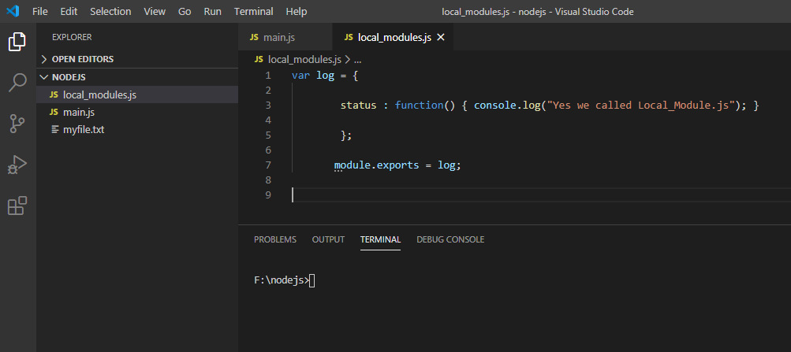
Implementing Local Modules
Code inside Local Module

Slide 31
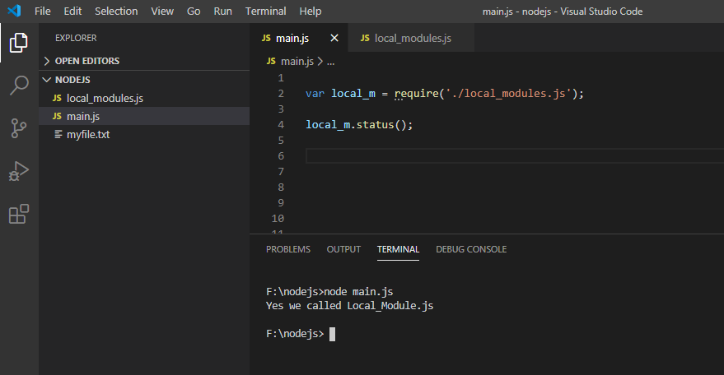
Implementing Local Modules
Execute ‘main.js’ and see output

Slide 32
Implementing Local Modules
How it worked?
In the end, we have assigned log object to module.exports. The module.exports in the above example exposes a log object as a module.
The module.exports is a special object which is included in every JS file in the Node.js application by default. Use module.exports or exports to expose a function, object or variable as a module in Node.js.
To use local modules in your application, you need to load it using require() function in the same way as core module. However, you need to specify the path of JavaScript file of the module.

Slide 33
Implementing Local Modules
In the above example, main.js is using ‘local_modules’ module.
First, it loads the desired module using require() function and specified path where module is stored.
Desired module is contained in ‘local_modules.js’ file in the root folder. So, we have specified the path './local_modules.js' in the require() function.
The '.' denotes a root folder.

Slide 34
Implementing Local Modules
The require() function returns a log object because an log object is exposed in ‘local_modules.js’ using module.exports.
So now you can use that this object and call any of its function using dot notation e.g local_m.status().

Slide 35
NPM
NPM stands for Node Package Manager
It is package manager for Node.js packages or modules.
Node Package Manager (NPM) is a command line tool that installs, updates or uninstalls Node.js packages in your application.
It is also an online repository for open-source Node.js packages. The node community around the world creates useful modules and publishes them as packages in this repository.

Slide 36
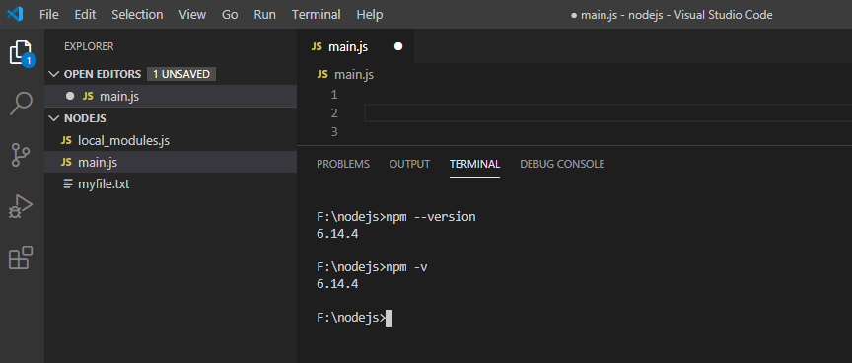
NPM
NPM is included with Node.js installation. After you install Node.js, verify NPM installation by writing the following command in terminal or command prompt.

Slide 37
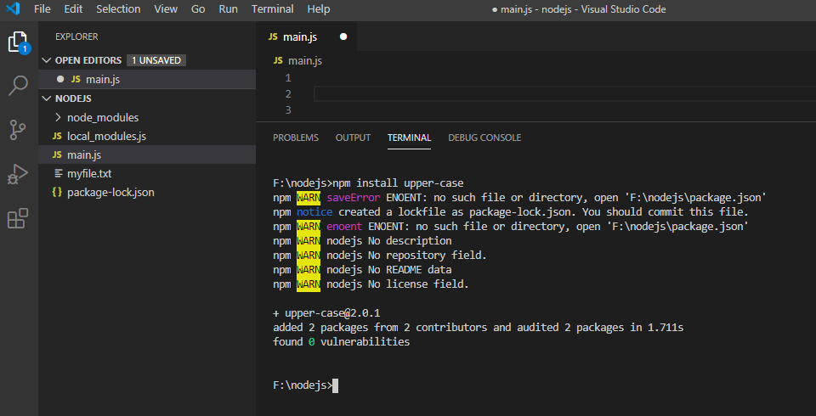
NPM
An example by installing third party module ‘upper-case’

Slide 38
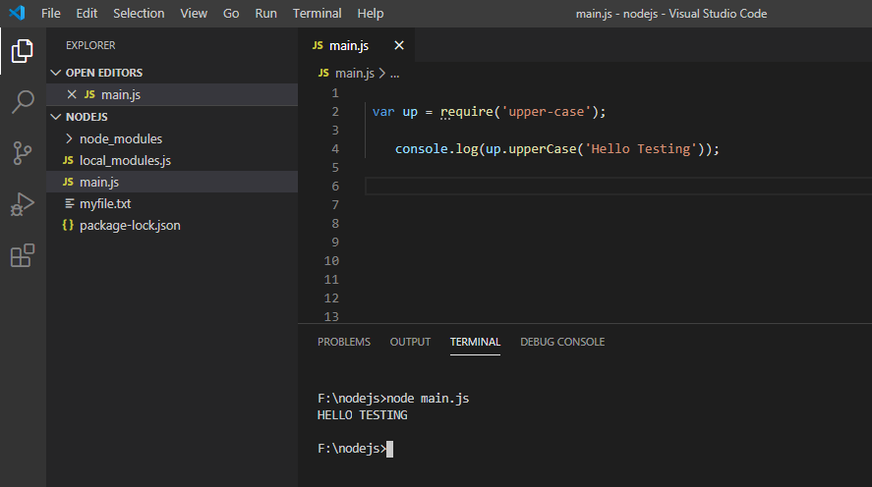
External Modules
Implementing ‘third party module’

Slide 39
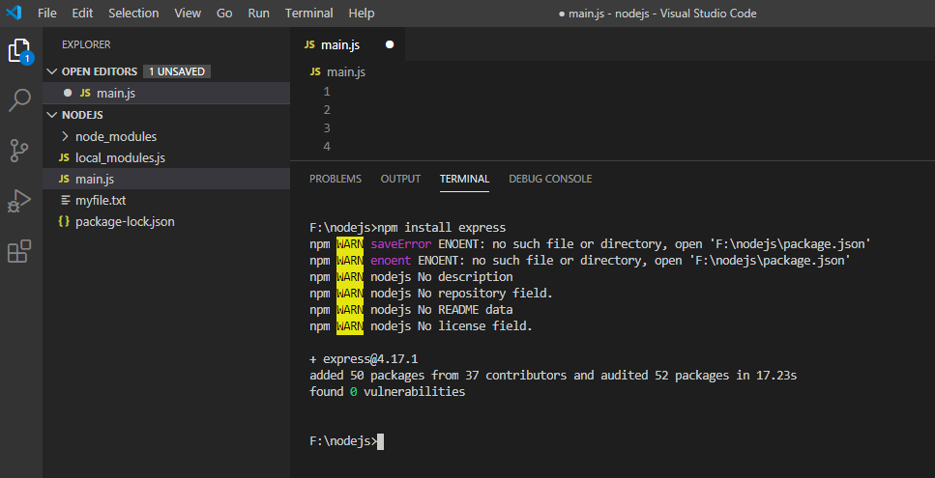
Module - Express
Express can also be installed in similar manner module
We can check dependencies in ‘package.json’
JSON - Java Script Object Notation

Slide 40
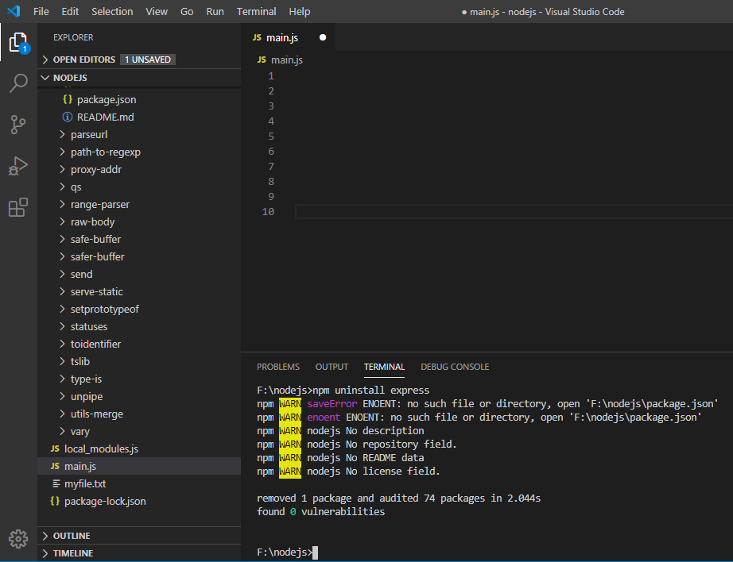
Uninstall Module
Uninstall of packages/modules

Slide 41
Callbacks Concept
A callback function is called at the completion of a given task.
Callback is an asynchronous equivalent for a function. Node makes heavy use of callbacks.
All the APIs of Node are written in such a way that they support callbacks.

Slide 42
Callbacks Concept
Let us take an example
A function to read a file may start reading file and return the control to the execution environment immediately so that the next instruction can be executed.
Once file I/O is complete, it will call the callback function while passing the callback function, the content of the file as a parameter.
So there is no blocking or wait for File I/O. This makes Node.js highly scalable, as it can process a high number of requests without waiting for any function to return results.

Slide 43
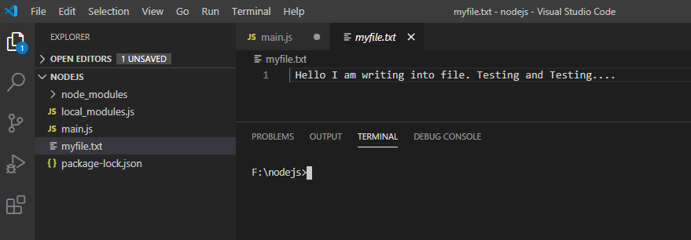
Callbacks Concept
First Create a .txt file. Let a file created with name ‘ myfile.txt’ , type some content inside it and save.

Slide 44
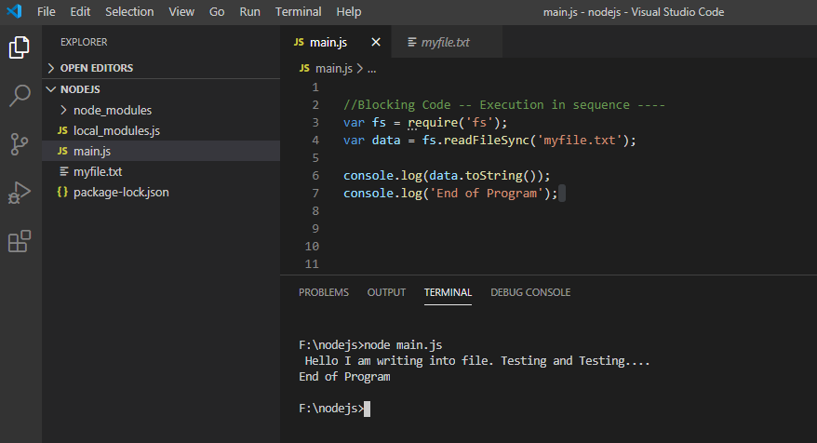
Callbacks Concept
Blocking Code

Slide 45
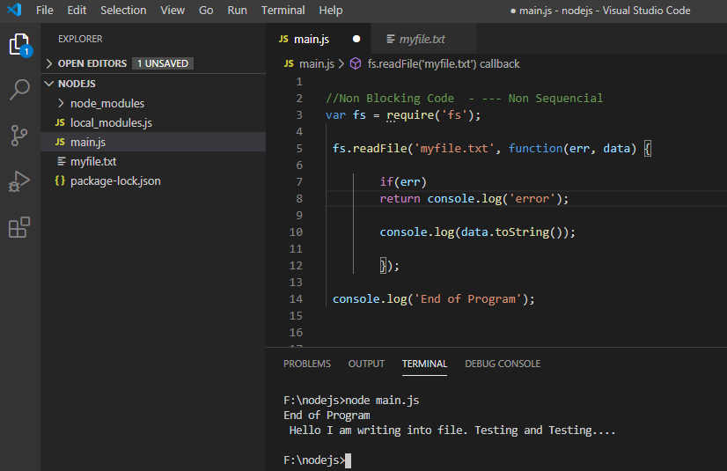
Callbacks Concept
Non Blocking Code

Slide 46
Events and Events Emitter
Node.js is a single-threaded application, but it can support concurrency via the concept of event and callbacks.
Every API of Node.js is asynchronous and being single-threaded, they use async function calls to maintain concurrency.
Node uses observer pattern. Node thread keeps an event loop and whenever a task gets completed, it fires the corresponding event which signals the event-listener function to execute.

Slide 47
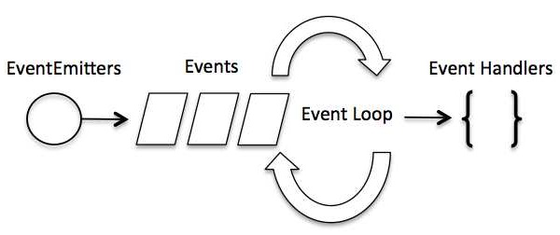
Events and Events Emitter
Event-Driven Programming
Node.js uses events heavily and it is also one of the reasons why Node.js is pretty fast compared to other similar technologies. As soon as Node starts its server, it simply initiates its variables, declares functions and then simply waits for the event to occur.
In an event-driven application, in general there is a main loop that listens for events, and then triggers a callback function when one of those events is detected.

Slide 48
Events and Events Emitter
Although events look quite similar to callbacks, the difference lies in the fact that callback functions are called when an asynchronous function returns its result, whereas event handling works on the observer pattern.
The functions that listen to events act as Observers. Whenever an event gets fired, its listener function starts executing. Node.js has multiple in-built events available through events module and EventEmitter class which are used to bind events and event-listeners

Slide 49
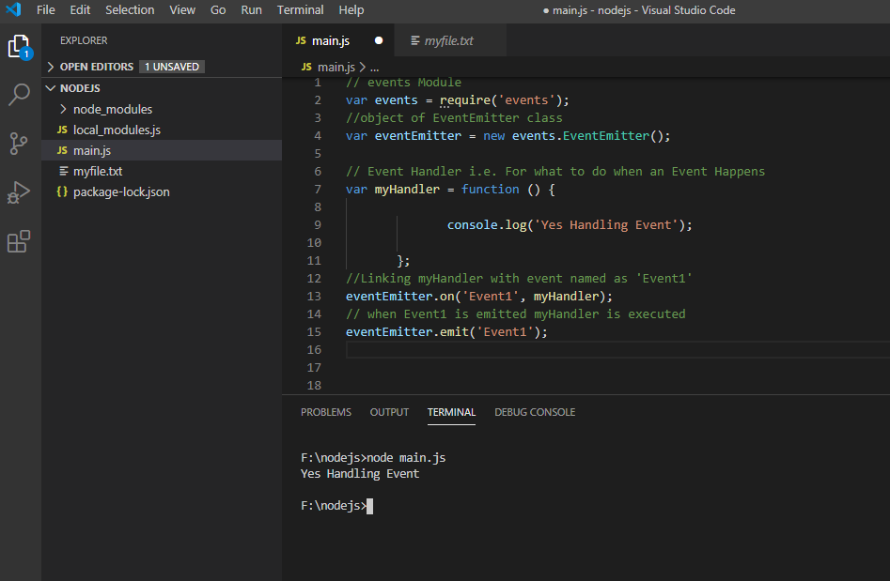
Events and Events Emitter
Understand the Example

Slide 50
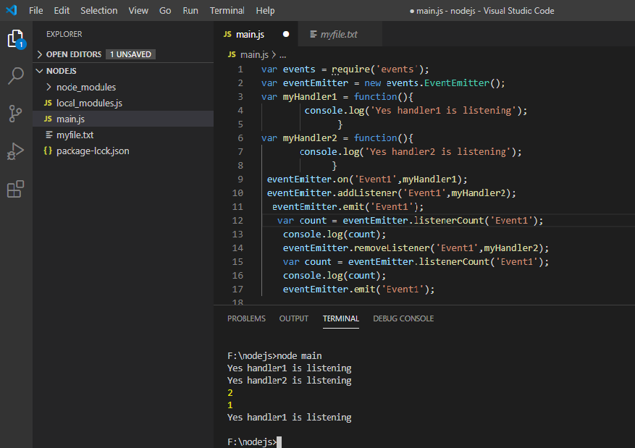
Events and Events Emitter
More methods of Events

Slide 51
Buffers
Pure JavaScript is Unicode friendly, but it is not so for binary data.
While dealing with TCP streams or the file system, it's necessary to handle octet streams.
Node provides Buffer class which provides instances to store raw data similar to an array of integers but corresponds to a raw memory allocation outside the V8 heap.
Buffer class is a global class that can be accessed in an application without importing the buffer module.

Slide 52
Buffers
JavaScript has no mechanism of dealing i.e. reading, manipulating with binary data.
Buffer class was introduced as part of Node.js APIs to make it possible.
Node.js server has to also deal with TCP streams and reading and writing to file systems with binary stream of data.

Slide 53
Buffers
What is a Buffer
Buffer is a temporary storage.
It is used to handle raw binary data.
Instances of Buffer class is like an array of integers.
The ‘integers’ in a buffer each represents one byte.
The size of buffer is established at the time of creation and can’t be resized again.
When buffer is full data is sent for processing.

Slide 54
Buffers
How Buffer Works
Buffer storing 10 Bytes
Large Data
Data Chunk
1 Byte

Slide 55
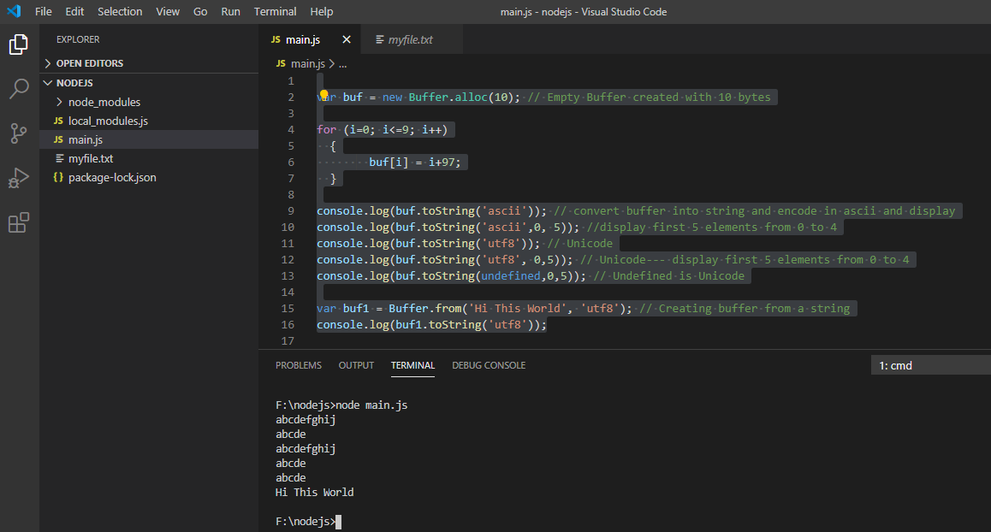
Buffers
Using Buffers

Slide 56
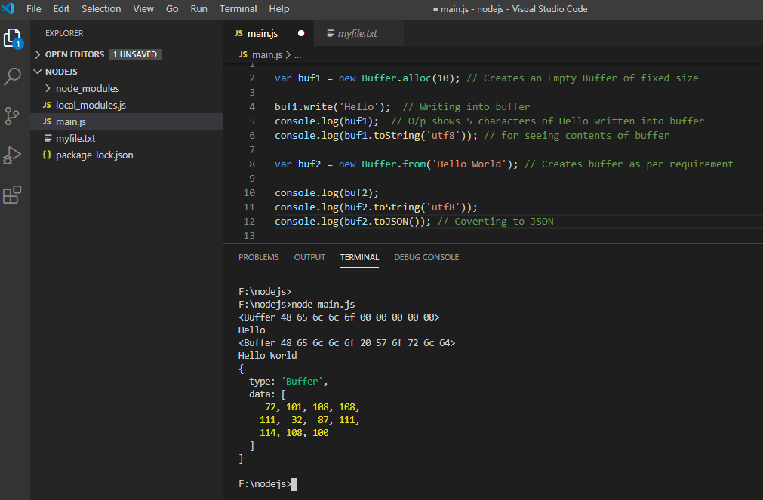
Buffers
Writing into Buffers and displaying contents of Buffer

Slide 57
Node.js Server and Application
Creating Node.js Application
Step 1 - Import Required Module
We use the require directive to load the http module and store the returned HTTP instance into an http variable as follows −
var http = require("http");

Slide 58
Components of Node.js
Before creating an actual “Hello World" like application using Node.js.
Let us understand the 3 basic components of Node.js
Import required modules − First is the require directive used to load Node.js modules.
Create server − Used for creating a server which will listen to client's requests similar to Apache HTTP Server.
Read request and return response − The server created in an earlier step will read the HTTP request made by the client which can be a browser or a console and return the response.

Slide 59
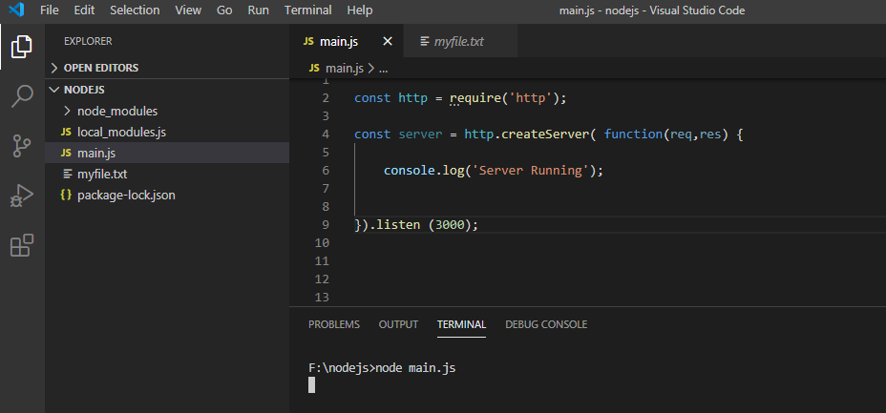
Create Server
Creating a Server
Notice Server is Running

Slide 60
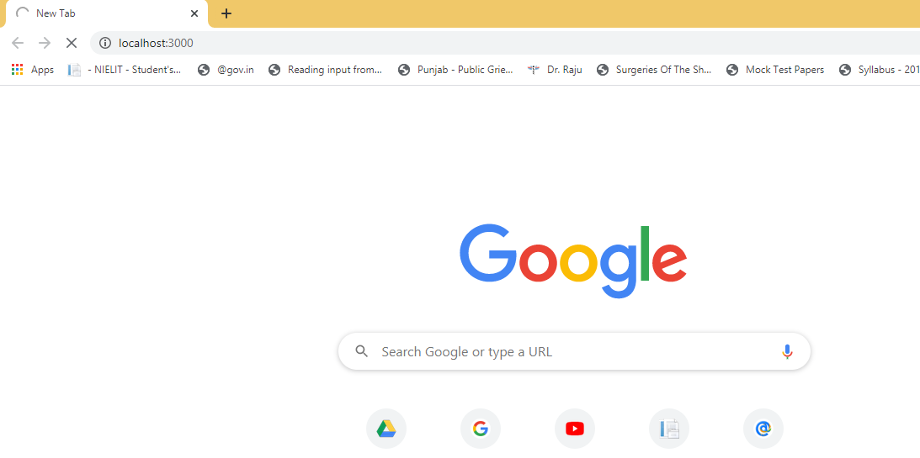
Working Server
Go to Web Browser
Type localhost:3000 in address bar/url bar

Slide 61
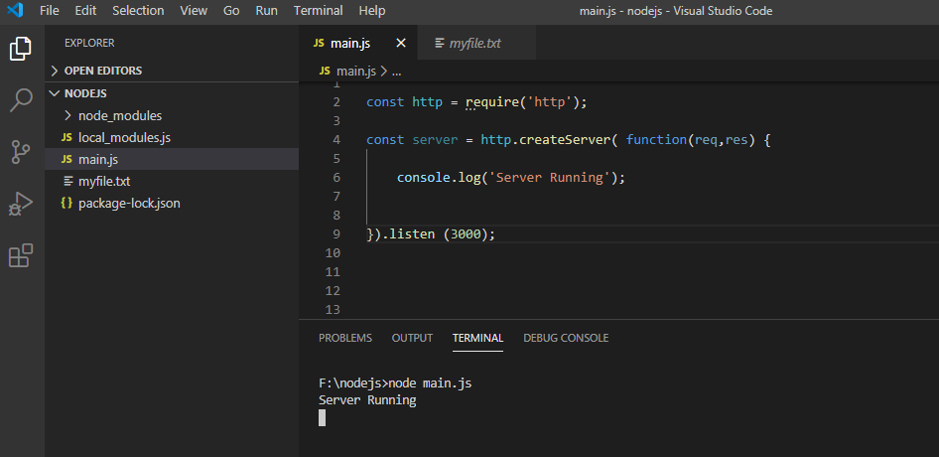
Working Server
Now check at Console--- See the message ‘Server Running’

Slide 62
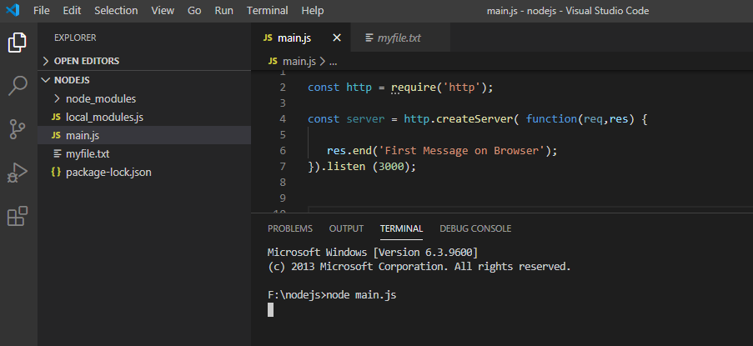
Working Server
Displaying message on Browser

Slide 63
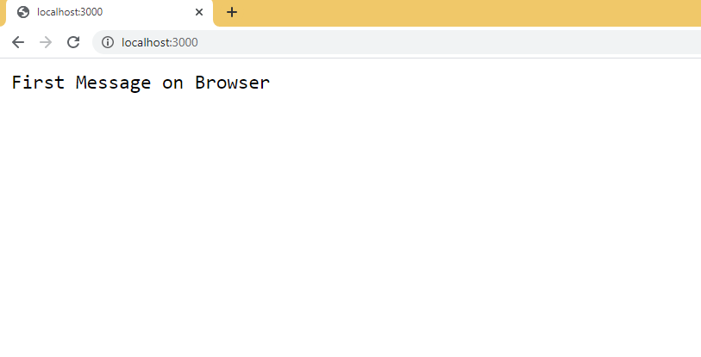
Working Server
After running server i.e. Executing file ‘main.js’
Go to browser and type localhost:3000 in address bar/url bar

Slide 64
Node.js - Streams
What are Streams?
Streams are objects that allow us to read data from a source or write data to a destination continuously. In Node.js, there are four types of streams −
Readable − Stream used for read operation.
Writable − Stream used for write operation.
Duplex − Stream used for both read and write operation.
Transform − This is a type of duplex stream that can transform data as it is written and read

Slide 65
Node.js - Streams
Each type of Stream is an EventEmitter instance and throws several events at different instance of times. For example, some of the commonly used events are −
data − This event is fired when there is data available to read.
end − This event is fired when there is no more data to read.
error − This event is fired when there is any error receiving or writing data.
finish − This event is fired when all the data has been flushed to underlying system.

Slide 66
Node.js - Streams
Buffer storing 10 Bytes
Large Data
Data Chunk
Data Chunk
1 Byte
Stream

Slide 67
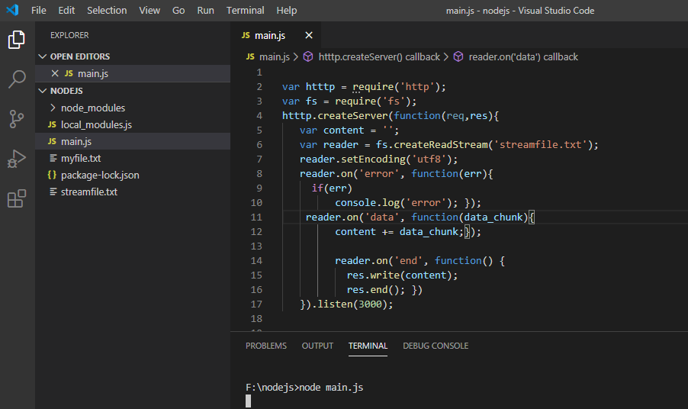
Node.js - Streams
Stream implementation for Reading a file and displaying its content on browser

Slide 68
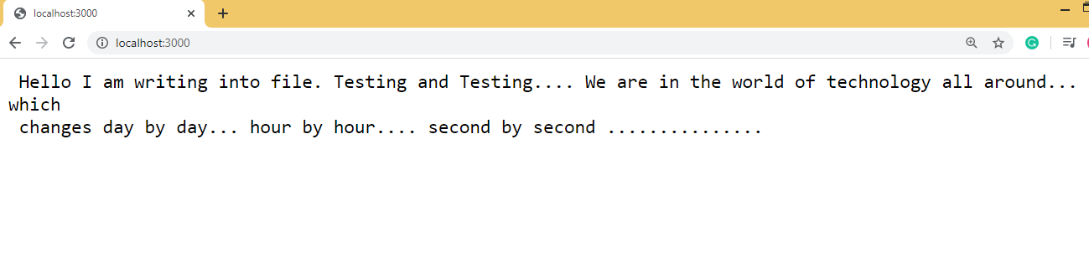
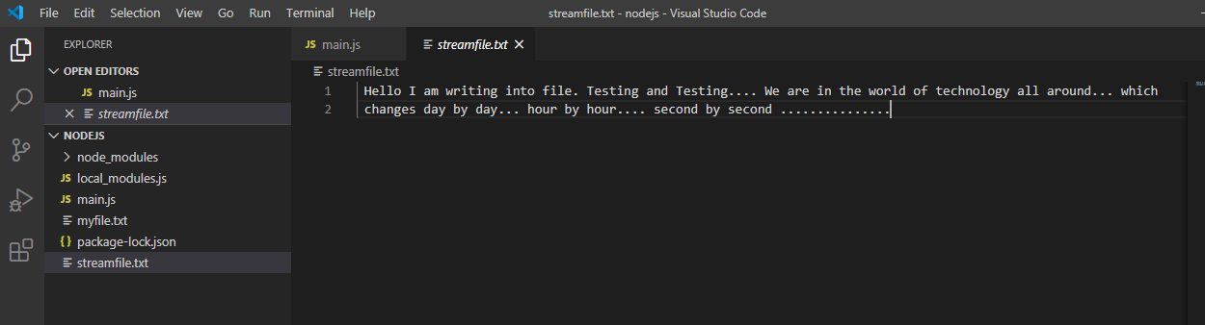
Node.js - Streams
Output on browser
Contents of file ‘streamfile.txt’

Slide 69
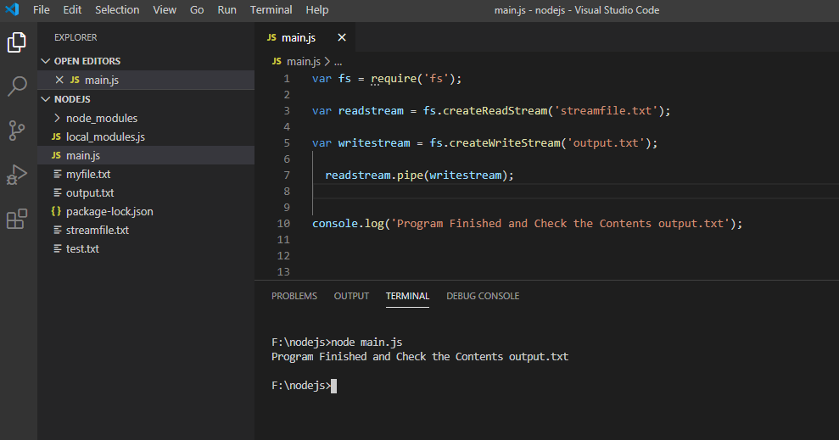
Node.js – Streams
Piping the streams - Piping is a mechanism in which the output of one stream goes as the input to another stream
Create a new ‘output.txt’ file and than close the output.txt file.

Slide 70
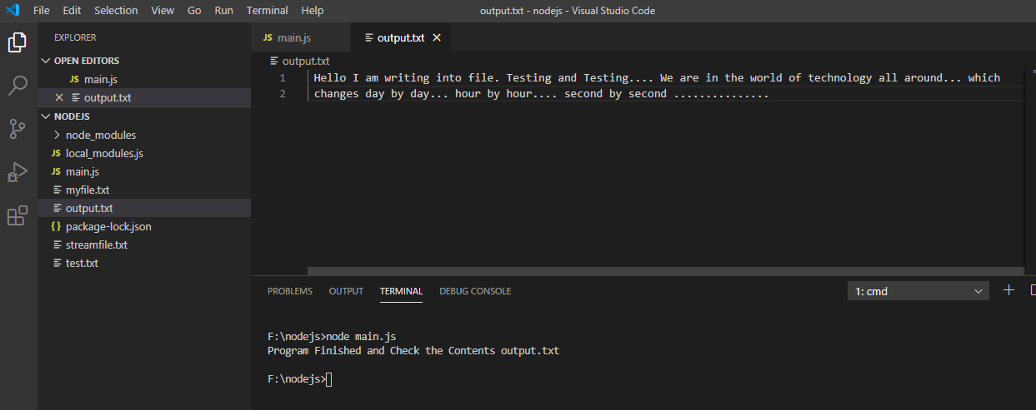
Node.js – Streams
After executing main.js.
Open the output.txt and check the output.

Slide 71
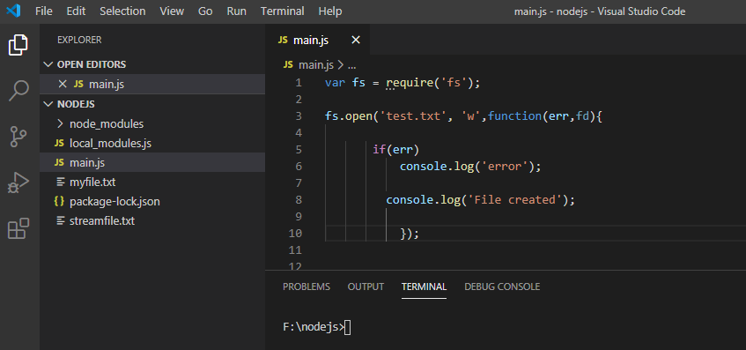
File Handling in Node.js
Creating a File with name ‘test.txt’
Write the code in main.js
Notice on explorer bar no file exist with name ‘test.txt’

Slide 72
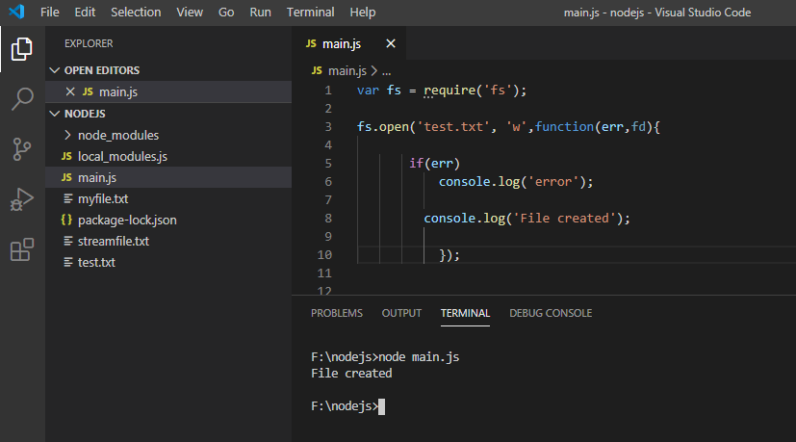
File Handling in Node.js
Now, run main.js
Notice output on console and Explorer Bar

Slide 73
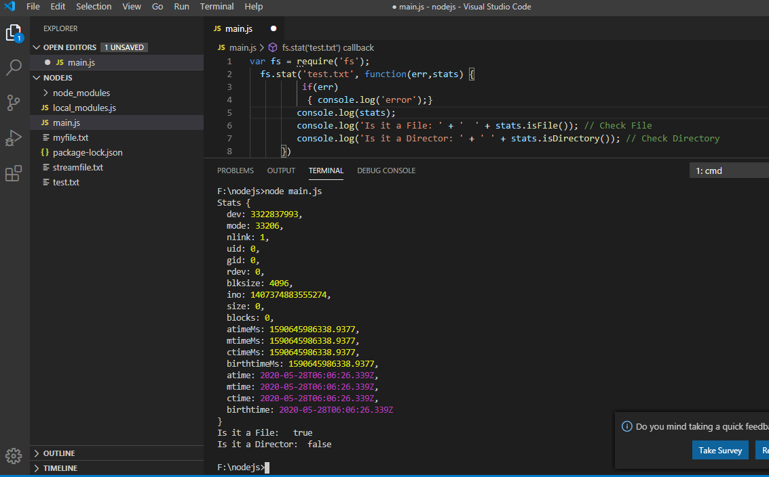
File Handling in Node.js
Getting File Information
Using Stat method

Slide 74
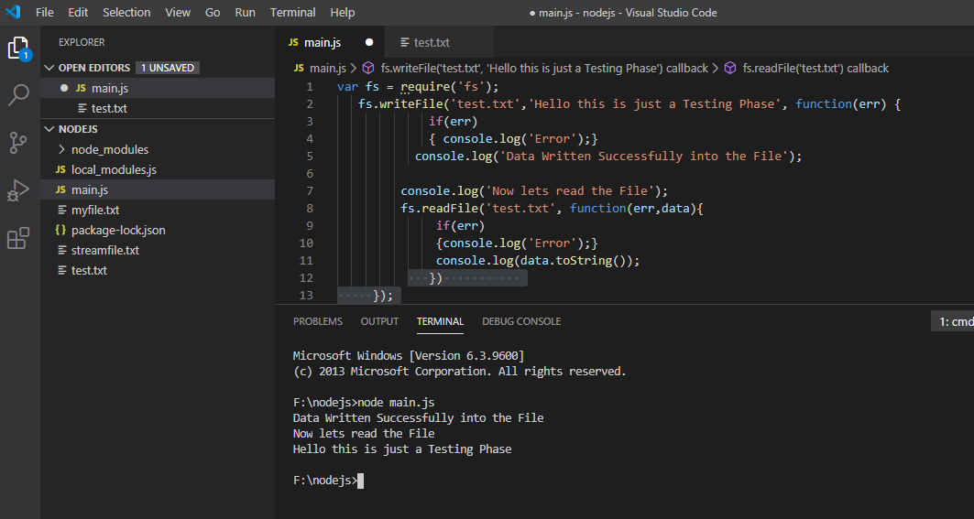
File Handling in Node.js
Writing and Reading a File.
For writing into an existing file use function appendFile().

Slide 75
Global Objects
Node.js console is a global object and is used to print different levels of messages to stdout and stderr. There are built-in methods to be used for printing informational, warning, and error messages.
It is used in synchronous way when the destination is a file or a terminal and in asynchronous way when the destination is a pipe.
Methods are like ‘console.log()’, ‘console.info()’, ‘console.dir()’

Slide 76
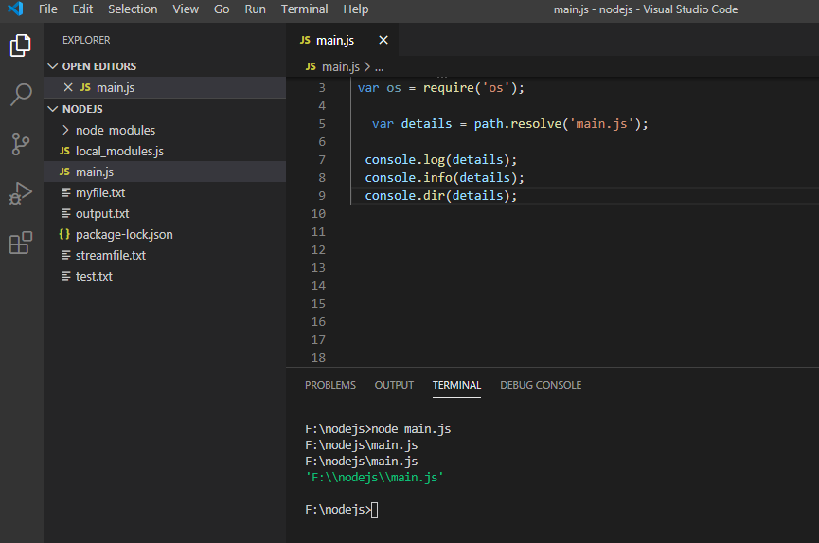
Global Objects
Check the output.

Slide 77
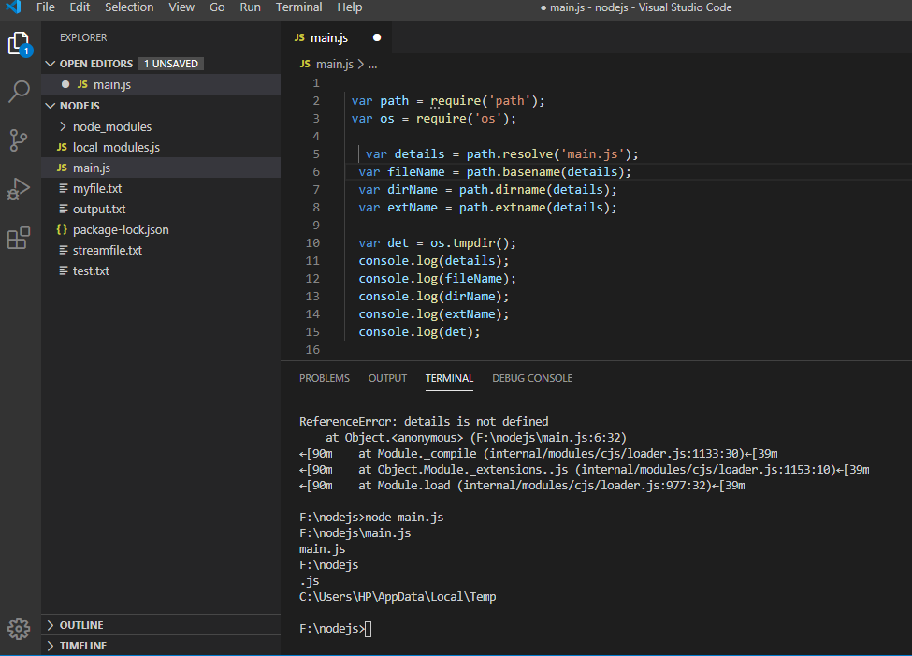
Utility Modules
Example of ‘path’ and ‘os’ module

Slide 78
Finish

